Slide 1
Organizing and Staffing
What is Organizing
Purpose of Organizing
Importance and process of organization
Types of organization
Organizational Structure
Span of control

Slide 2
What is organizing?
Arranging and structuring work to accomplish organizational goals

Slide 3
Purpose of Organizing
Divides work to be done into specific jobs and departments
Assigns tasks and responsibilities associated with individual jobs
Coordinates diverse organizational tasks
Clusters jobs into units
Establishes relationships among individuals, groups, and departments
Establishes formal lines of authority
Allocates and deploys organizational resources

Slide 4
Organizational Structure
It is a formal arrangement of jobs within organization
We can illustrate the organizational structure by using “organizational chart”
When managers create or change the structure, they’re engaged in “organizational design”

Slide 5
Common Elements of Organization
Common Purpose
Coordinated Effort
Division of Labor
Hierarchy of Authority
Span of Control
Authority, Responsibility, & Delegation
Centralization v.s. Decentralization of Authority
Proposed by Edgar Schien, professor in organizational development
Most authorities agree on

Slide 6
Common Purpose
The means for unifying members
The common purpose unifies employees or members and give everyone an understanding of organization’s reason for being
An organization without purpose soon begin to drift and become disorganized

Slide 7
Coordinated Effort
Working together for common purpose
The common purpose is realized through coordinated effort, the coordination of individual efforts into a group or organization-wide effort
Individuals can make a difference, however, they cannot do everything by themselves

Slide 8
Division of Labor
Work specialization for greater efficiency
Division of labor is the arrangement of having discrete parts of a task done by different people
With division of labor, an organization can parcel out the entire complex work effort to be performed by specialists, resulting in greater efficiency

Slide 9
Assignment (individual)
Find 2 articles, from reliable sources, related to:
  Effective management
  Ineffective management
Analyze those articles in your own word (handwriting only)
Due date: next class

Slide 10
Organizing Process
Job Design
Organizational Structure Design
Authority Allocation
Coordination
Chain of command
Span of control
Delegation
Centralized or Decentralized

Slide 11
Job Design
The number, kind, and variety of tasks that individual workers perform in doing their jobs.
  Job Specialization: a job composed of a small part of a larger task or process

Slide 12
Alternatives to Job Design
  Job Rotation: periodically moving workers from specialized job to another to give them more variety and opportunity to use different skills
  Job Enlargement: increasing the number of tasks that a worker performs within one particular job
  Job Enrichment: increasing the number of tasks in a particular job and giving workers the authority and control to make meaningful decisions about their work

Slide 13
Organizing Process
Job Design
Organizational Structure Design
Authority Allocation
Coordination
Chain of command
Span of control
Delegation
Centralized or Decentralized

Slide 14
8 Types of Organizational Arrangement
Simple Structure
Functional Structure
Divisional Structure
Conglomerate Structure
Hybrid Structure
Matrix Structure
Team-Based Structure
Network Structure

Slide 15
1. Simple Structure
For a small firm
An organization with a simple structure has authority centralized in a single person, a flat person, a flat hierarchy, few rules, and low work specialization
Owner
Administrative Assistant
Simple structure: an example
There is only one hierarchical level of management beneath the owner

Slide 16
2. Functional Structure
Grouping by similar work specialty
In a functional structure, people with similar occupational specialties are put together in formal groups
President
Structure for a Business
Vice President, Marketing
Vice President, Finance
Vice President, Production
Vice President, Human Resources
Chief Administrator
Structure for a hospital
Chief of Medical Services
Director of Admistrative Services
Director of Outpatient Services
Director of Nutrition & Food Services

Slide 17
3. Divisional Structure
Grouping by similarity of purpose
In a divisional structure, people with diverse occupational specialties are put together in formal groups by similar products or services, customers or clients, or geographic regions

Slide 18
Divisional Structure
Product divisional structure
President
Motion Pictures & Television Division
Music Division
Magazine Division
Internet Product Division
President
Customer divisional structure
Consumer Loans
Mortgage Loans
Business Loans
Agricultural Loans
President
Geographic divisional structure
Western Region
Northern Region
Southern Region
Eastern Region

Slide 19

4. Conglomerate Structure
Grouping by industry
The conglomerate structure groups divisions or business units around similar businesses or industries
This resemble the structure of Tyco International, a global manufacturing company
President
Electronics
Fire & Security
Healthcare
Plastics & Adhesives
Engineered Products & Services

Slide 20
5. Hybrid Structure
Functional & divisional used within the same organization
In a hybrid structure, an organization uses functional and divisional structures in different parts of the same organization

Slide 21

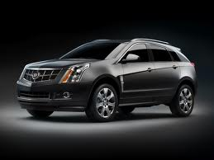

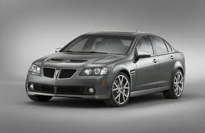
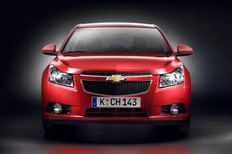
Hybrid Structure
CEO
General Motors
Product divisional structure
President, Cadilac
President, Buick
President, Pontiac
President, Chevrolet
Vice President, Production
Vice President, Marketing
Vice President, Finance
Vice President, Human Resources
Functional structure
Manager, Region I
Manager, Region II
Manager, Region III
Manager, Region IV
Geographical divisional structure

Slide 22
6. Matrix Structure
A grid of functional & divisional for 2 chains of command
In a matrix structure, an organization combines functional and divisional chains of commands in a grid so that there are 2 command structures—vertical and horizontal

Slide 23

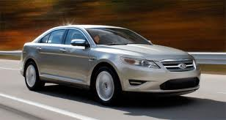
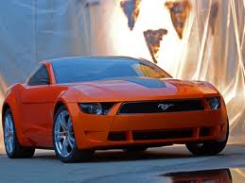
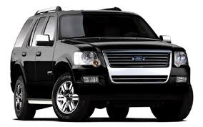

Matrix Structure
An example of an arrangement that Ford might use
President
Functional Structure
Project Structure
Vice President, Engineering
Vice President, Finance
Vice President, Production
Vice President, Marketing
Project Manager, Taurus
Project Manager, Mustang
Project Manager, Explorer
Project Manager, Expedition
Subordinate reports to both VP of Marketing (above) and Project Manager for Expedition

Slide 24
7. Team-Based Structure
Eliminating functional barriers to solve problems
In a team-based structure, teams or workgroups, either temporary or permanent, are used to improve horizontal relations and solve problems throughout the organization
When managers from different functional divisions are brought together in teams —known as cross functional teams—to solve particular problems, the barriers between the divisions break down.

Slide 25
Team-based structure
President
Functional structure
Vice President, R&D
Vice President, Design
Vice President, Engineering
Vice President, Marketing
Project teams
Product Team Manager, Manufacturing, Light Trucks
Product Team Manager, Manufacturing, Sedans
Product Team Manager, Manufacturing, Sport Cars
Project team members

Slide 26
8. Network Structure
Connecting a central core to outside firms by computer connections
The network structure is the organization has a central core that is linked to outside independent firms by computer connections, which are used to operate as if all were a single organization
Corporations using this structure are sometimes called virtual corporations

Slide 27
Network structure
Example of a personal computer company
Design studio: Sweden
Component assembly: Mexico, Asia
Core of
personal
computer
company
USA
Engineering company: Japan
Distribution company: Canada
Accounting & finance: USA

Slide 28
Organizing Process
Job Design
Organizational Structure Design
Authority Allocation
Coordination
Chain of command
Span of control
Delegation
Centralized or Decentralized

Slide 29
Hierarchy of Authority
Or the Chain of Command
It is a control mechanism for making sure the right people do the right things at the right time
Without tiers or ranks of authority, a lone manager would have to confer with everyone in his/her domain, making it difficult to get things done

Slide 30
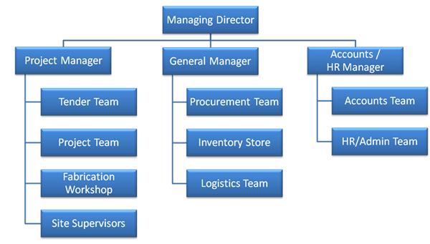
Example

Slide 31
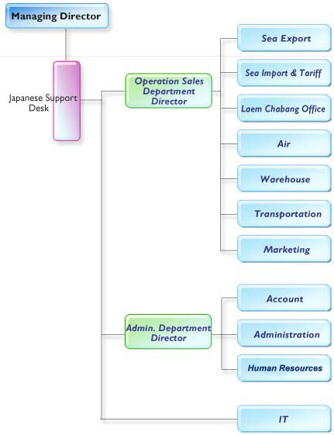
MEIKO TRANS (THAILAND) CO., LTD

Slide 32
Span of Control:
Narrow (or Tall) v.s. Wide (or Flat)
or span of management, refers to the number of people reporting directly to a given manager
There are 2 kinds of spans of control:
  Narrow (or tall): manager has limited number of people reporting — more managers are required, managers can communicate quickly to subordinates and control them easily
  Wide (or flat): manager has several people reporting—less managers are required = more efficient in terms of cost, the message reaches more employees faster, faster decision making

Slide 33
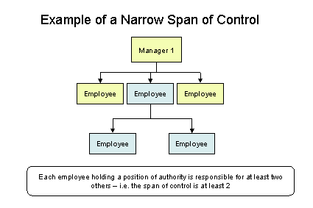
The advantages of a narrow span of control are:
A narrow span of control allows a manager to communicate quickly with the employees under them and control them more easily
Feedback of ideas from the workers will be more effective

Slide 34
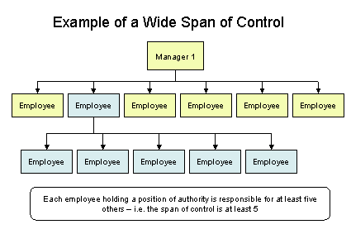
The advantages of wide span of control are:
There are less layers of management to pass a message through, so the message reaches more employees faster
It costs less money to run a wider span of control because a business does not need to employ as many managers

Slide 35
Authority, Responsibility, & Delegation: Line vs. Staff Position
Authority refers to the rights inherent in a managerial position to make decisions, give orders, and utilize resources
Authority means accountability—managers must report and justify work results to the managers above them
Being accountable means you have the responsibility for performing assigned tasks

Slide 36
Authority, Responsibility, & Delegation: Line vs. Staff Position
Responsibility is the obligation you have to perform the tasks assigned to you
Example: a car assembly-line worker has little authority but also little responsibility: just install those windshields over and over. Manager, however, has greater responsibilities
With more authority comes more responsibility

Slide 37
Authority, Responsibility, & Delegation: Line vs. Staff Position
Delegation is the process of assigning managerial authority and responsibility to managers and employees lower in the hierarchy
To be more efficient, most managers are expected to delegate as much of their work as possible

Slide 38
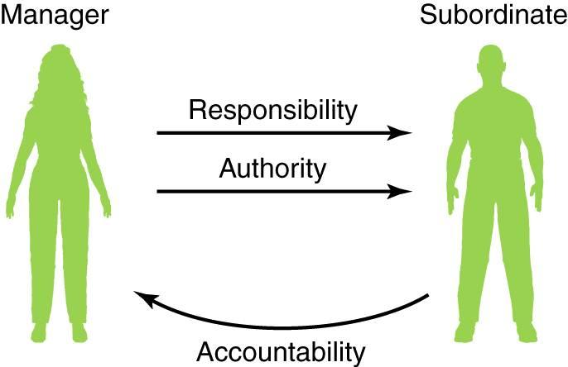
Delegation: Responsibility, Authority, and Accountability

Slide 39
Authority, Responsibility, & Delegation: Line vs. Staff Position
Regarding authority and responsibility, the organization chart distinguishes between 2 positions:
  Line position: Line managers have authority to make decisions and usually have people reporting to them (are indicated by solid line)
  Staff position: Staff personnel have authority function; they provide advice, recommendations, and research to the line managers (are indicated by dotted line)

Slide 40
Line and Staff
Board of Directors
Staff
Line
Strategic Planning Advisor
CEO
Legal Counsel
President
Cost-Containment Staff
Executive Administrative Director
Executive Medical Director

Slide 41


Centralization vs. Decentralization of Authority
With centralized authority, important decisions are made by high-level managers
Very small companies tend to be the most centralized, however, Kmart and McDonald are using this kind of authority
Advantages:
  Less duplication of work (fewer employees perform the same task; rather, the task is often performed by a department of specialists)
  Procedures are uniform and thus easier to control

Slide 42

Centralization vs. Decentralization of Authority
With decentralized authority, important decisions are made by middle-level and supervisory-level managers
Here, obviously, power has been delegated throughout the organization. General Motors and Sears are using this kind of authority
Advantages:
  Managers are encouraged to solve their own problems rather than to buck the decision to a higher level
  Decision are made more quickly, which increases the organization’s flexibility and efficiency

Slide 43
Organizing Process
Job Design
Organizational Structure Design
Authority Allocation
Coordination
Chain of command
Span of control
Delegation
Centralized or Decentralized

Slide 44
Coordination
Important Elements:
Coordinator
Roles & Responsibility
Rules & Regulations

Slide 45
THANK YOU

